Slide 1

Smart grid Integration of Self Driving Vehicles in urban networks
RESEARCH PROJECT G3
Prepared by:
Caio BRAGA SAMPAIO
Supervised by:
M. Bruno FRANÇOIS
M. Alexandre KRUSZEWSKI
30/03/2022

Slide 2
CONTENTS
01
02
03
04
05
06
INTRODUCTION
PATH PLANNING
SYSTEM SPECIFICATION
EXPERIMENTAL WORK
DESIGN AND ANALYSIS
CONCLUSION

Slide 3
INTRODUCTION
1

Slide 4
The ideia of the project
Increasing use of electrical vehicles (EVs)
Impacts on the electrical distribution network
Importance of the smart grid
Solution: Autonomous Electric Vehicles (AEV) that search for the most convenient charging point

Slide 5
The ideia of the project
Proposal: Apply this model on a reduced scale
To study the implementation of a path following robot
Studying methods of calculating and planning trajectories

Slide 6
SYSTEM SPECIFICATION
2

Slide 7
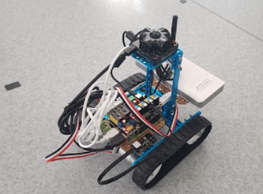
Prototype of the autonomous vehicle
Materials used:
Makebloc kit
A MegaPi control board, belonging to the Makebloc kit, based on the Arduino MEGA 2560.
A Gyroscope sensor, for monitoring along the robot movement of its orientation.
A Raspberry Pi 3 card.
And a MarvelMind kit, which is an indoor positioning system similar to a GPS.
Power Bank

Slide 8
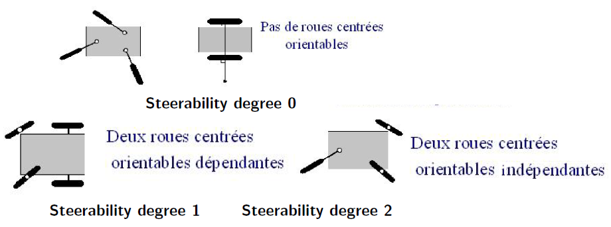
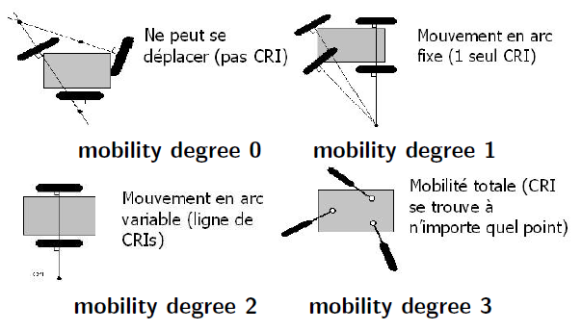
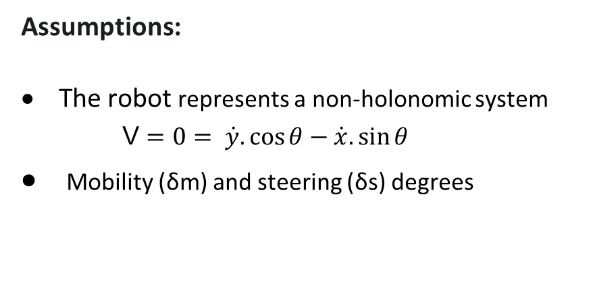
Modelling
Assumptions:
The robot represents a non-holonomic system
V $=0= \dot{y}.\cos{θ}−\dot{x}.\sin{θ}$
Mobility (δm) and steering (δs) degrees
Source: Perruquetti, W. Autonomous transport system

Slide 9
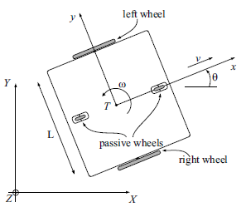

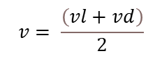
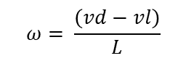
Equationing the dynamic system
Considering δm =2 and δs = 0
$$\dot{x}=v.\cos{θ}$$
$$\left[\begin{matrix}\dot{x} \\ \dot{y} \\ \dot{θ}\end{matrix}\right]=\left[\begin{matrix}\cos{θ} & 0 \\ \sin{θ} & 0 \\ 0 & 1\end{matrix}\right].\left[\begin{matrix}v \\ ω\end{matrix}\right]$$
$$\dot{y}=v.sin θ$$
$$\dot{θ}= ω$$
$$vl=v−\frac{ω.L}{2}$$
$$v= \frac{\left(vl+vd\right)}{2}$$
$$ω= \frac{\left(vd−vl\right)}{L}$$
$$vr=v+\frac{ω.L}{2}$$

Slide 10
DESIGN AND ANALYSIS
3

Slide 11

Motor Speed Control
Tests
Voltage and speed relation of the motors
Step response
$$G\left(s\right)= \frac{K}{τ.s+1}=\frac{1}{0.0095.s+1}$$
$$U= 28.83.v+1.04$$

Slide 12
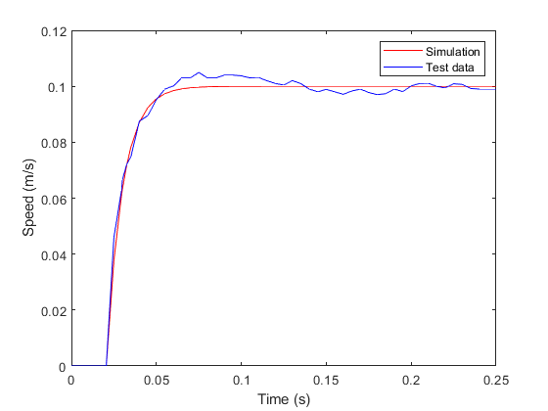
Motor Speed Control
Step response

Slide 13
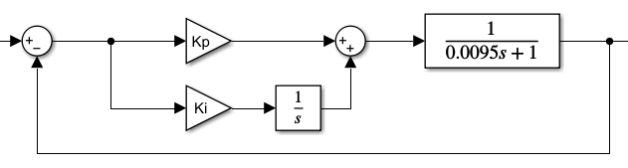
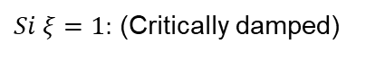


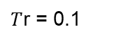

Motor Speed Control
PI Controller
Second Ordre System
$$G\left(s\right)=\frac{K.\left(Kp.s+Ki\right)}{K.\left(Kp.s+Ki\right)+s\left(τ.s+1\right)}$$
$Si ξ=1:$ (Critically damped)
$$ω= \frac{5}{Tr}$$
$$G\left(s\right)=\frac{\frac{K.Kp}{τ}.s+\frac{K.Ki}{τ}}{s^{2}+\frac{\left(K.Kp+1\right)}{τ}.s+\frac{K.Ki}{τ}}$$
$T$r = 0.1
$$Ki=23.75 and Kp=−0.05$$
$$Kp=\frac{\left(2.ξ.τ.ω−1\right)}{K}$$
$$Ki=\frac{τ.ω²}{K}$$

Slide 14
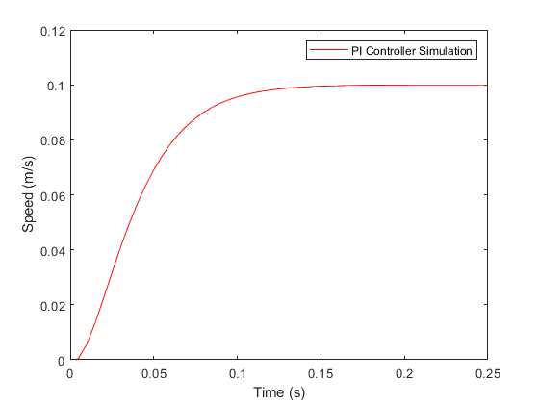
Motor Speed Control
PI Controller

Slide 15
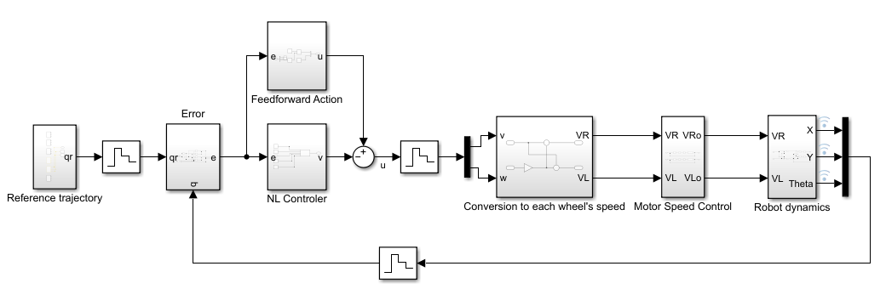
Path-following controller
Non-linear controller
Based on the work of (Kanayama, 1990) and (Klancar, Matko, & Blazic, 2005)

Slide 16
Path-following controller
Reference trajectory:
It is necessary to indicate for each point of the path to be followed by the robot, a reference posture qr(xr,yr,ϴr), that is, the Cartesian positions of the points and the angles that the robot must reach, taking its current position q(x,y,ϴ) as a basis.

Slide 17

Path-following controller
Error:
$$\left[\begin{matrix}e1 \\ e2 \\ e3\end{matrix}\right]=\left[\begin{matrix}\cos{θ} & \sin{θ} & 0 \\ −sin{θ} & \cos{θ} & 0 \\ 0 & 0 & 1\end{matrix}\right].\left[\begin{matrix}xr−x \\ yr−y \\ θr−θ\end{matrix}\right]$$

Slide 18

Path-following controller
FeedFoward Action:
$$u1=ur1.cose3$$
$$u2=ur2$$
Where ur1 is the tangential feedfoward speed and ur2 is the angular feedfoward speed.

Slide 19

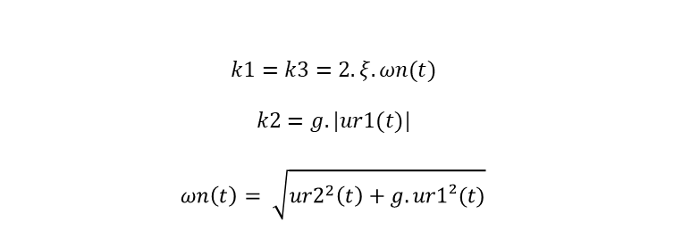
Path-following controller
Non Linear Controller:
$$k1=k3=2.ξ.ωn(t)$$
$$k2=g.|ur1(t)|$$
$$ωn\left(t\right)= \sqrt{ur2^{2}\left(t\right)+g.ur1²(t)}$$
$$\left[\begin{matrix}v1 \\ v2\end{matrix}\right]=\left[\begin{matrix}−k1 & 0 & 0 \\ 0 & −sign\left(ur1\right).k2 & −k3\end{matrix}\right].\left[\begin{matrix}e1 \\ e2 \\ e3\end{matrix}\right]$$
And the values of ξ and g are set by the user in order to adjust the desired response

Slide 20
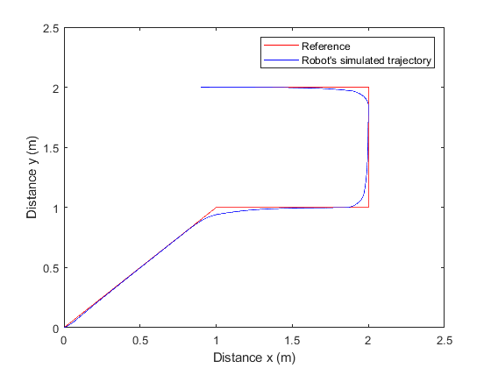
Path-following controller

Slide 21
Path Planning
4

Slide 22
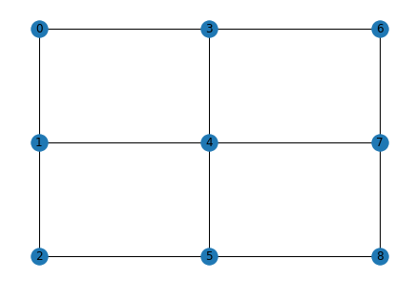
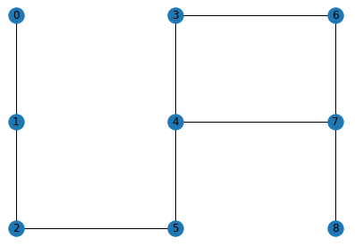
Dijkstra’s algorithm

Slide 23
Dijkstra’s algorithm
Algorithm operating logic
(i) Identify the desired end point and consider it with a zero distance and current point.
(ii) Find all the points connected to the current point. Check their distances and record the smallest
(iii) Mark the current point as visited and look no further at it
(iv) Mark the shortest distance point as current and repeat from step (ii)

Slide 24
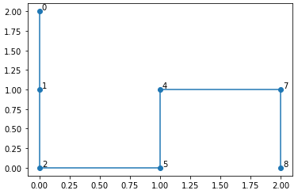
Dijkstra’s algorithm

Slide 25
EXPERIMENTAL WORK
5

Slide 26
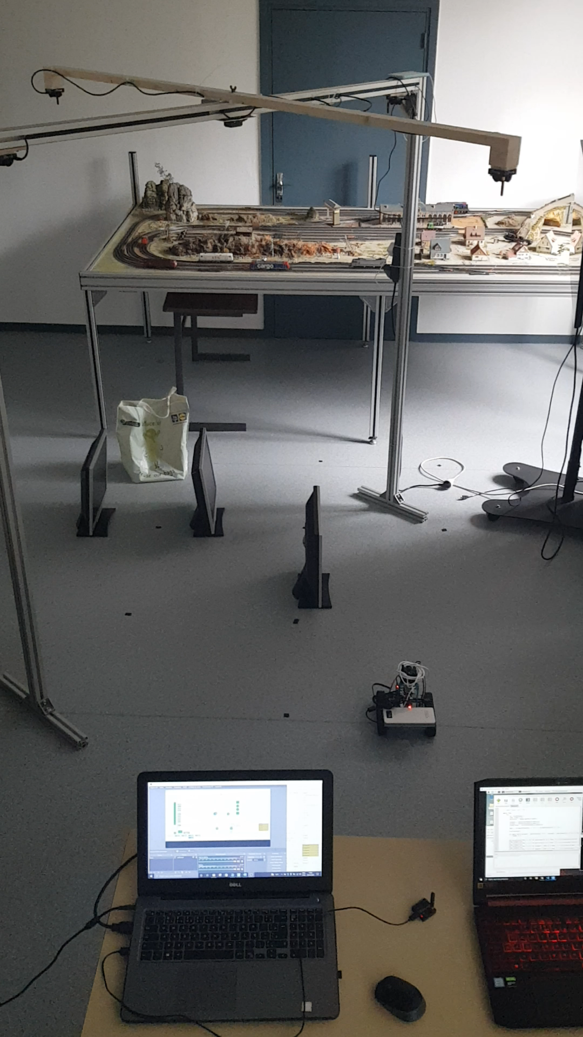

Slide 27
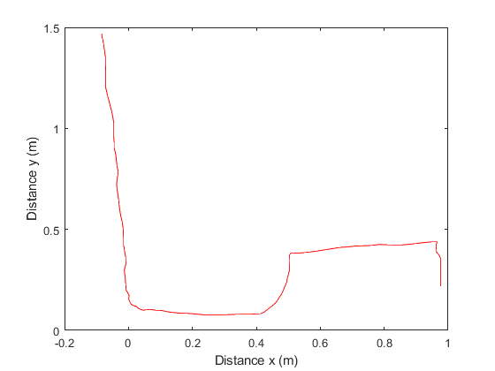

Slide 28
Conclusion
6

Slide 29
In this work, the application of a complex system of monitoring, control and trajectory calculation was presented. The results obtained in simulation and experimental were satisfactory, even considering the imprecisions of sensors and localization systems.
As next steps in the development of this project, it is suggested the implementation of a control in a 4-wheeled robot, making it closer to reality. Besides, it would be interesting to implement the prototype in more extensive environments, allowing the robot to trace longer trajectories.

Slide 30
Thank you for your attention!

